Slide 1
The Difficult Road Ahead: Confronting Racial Injustice in the Criminal Justice System, and Reducing the Prison Population
Senate President Tim Ashe

Slide 2
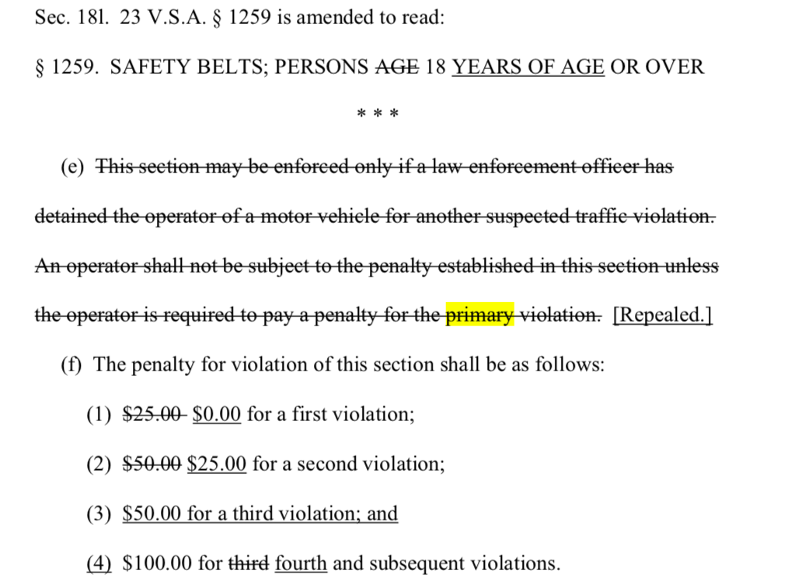

Slide 3
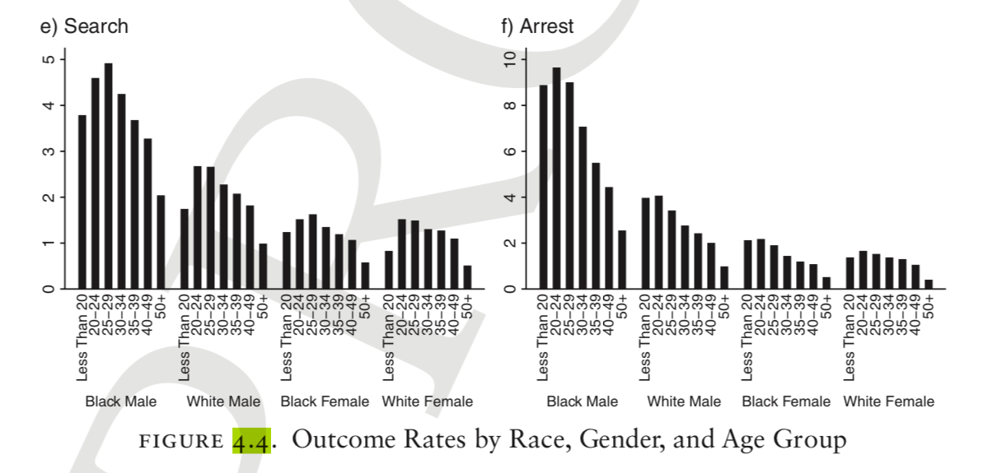
Source: Suspect Citizens book

Slide 4
Frequency of Vehicle Searches After Being Pulled Over in Vermont
Source: UVM Economics Professor Stephanie Seguino

Slide 5
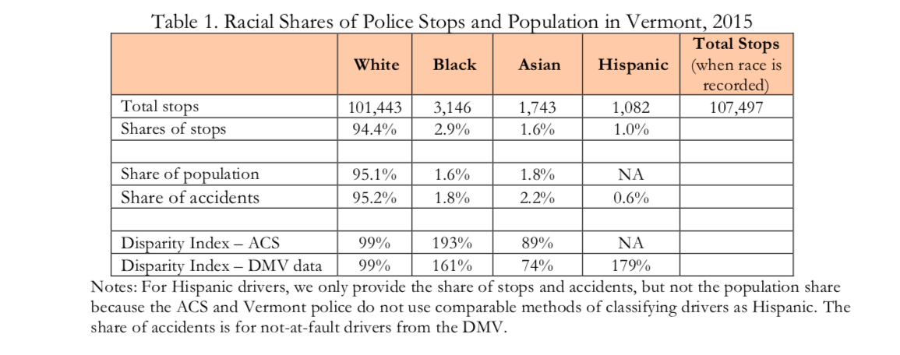

Slide 6
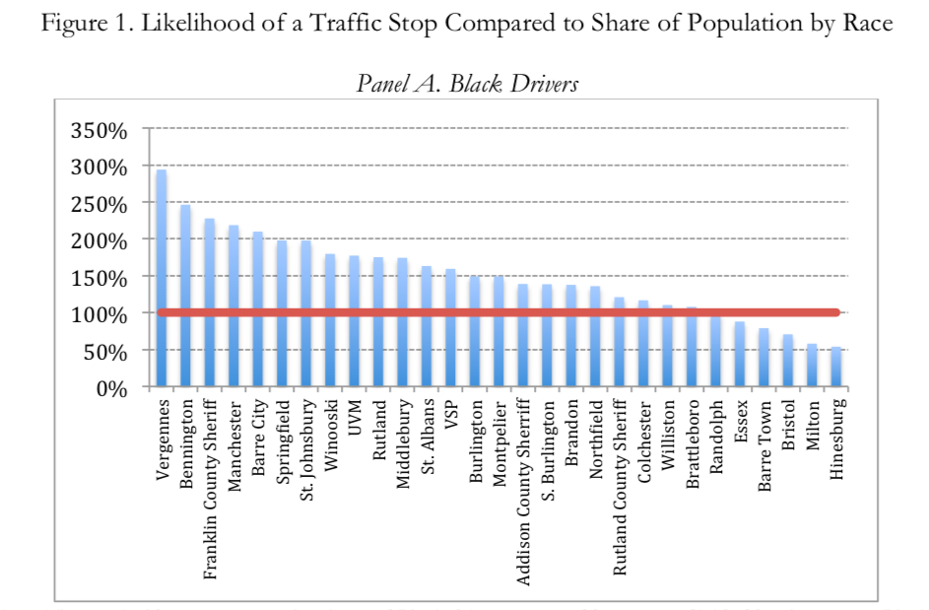

Slide 7
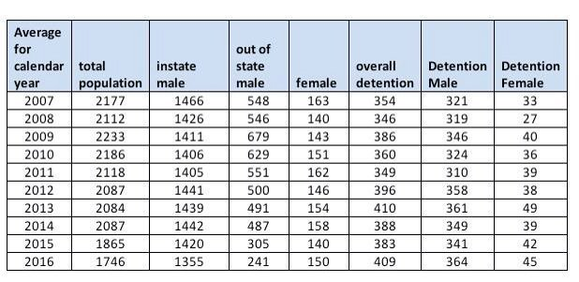
Total Inmate Population Going Down

Slide 9
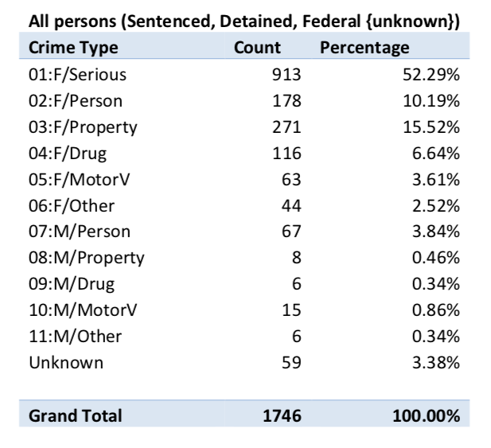
Who’s Incarcerated in Vermont

Slide 10
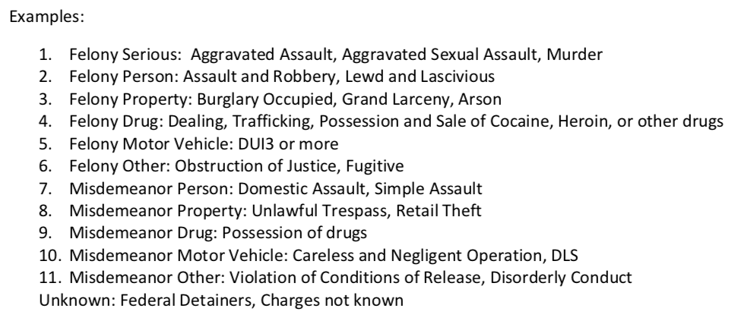

Slide 11
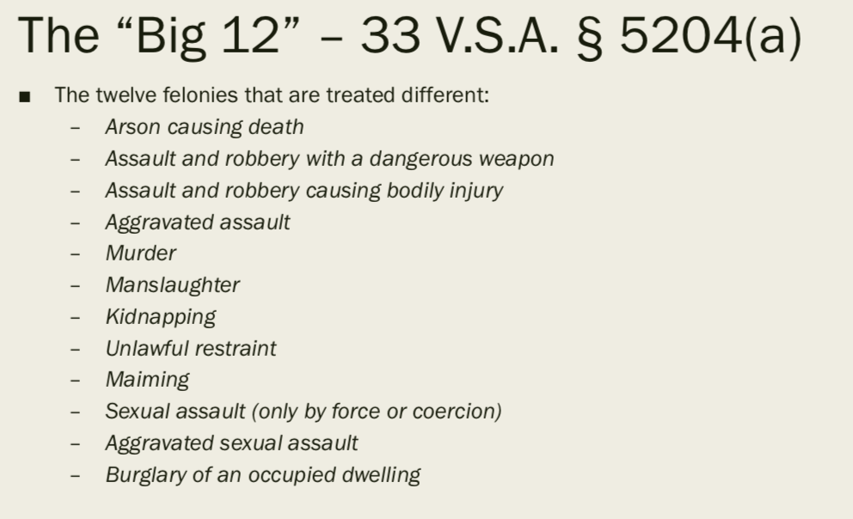

Slide 12
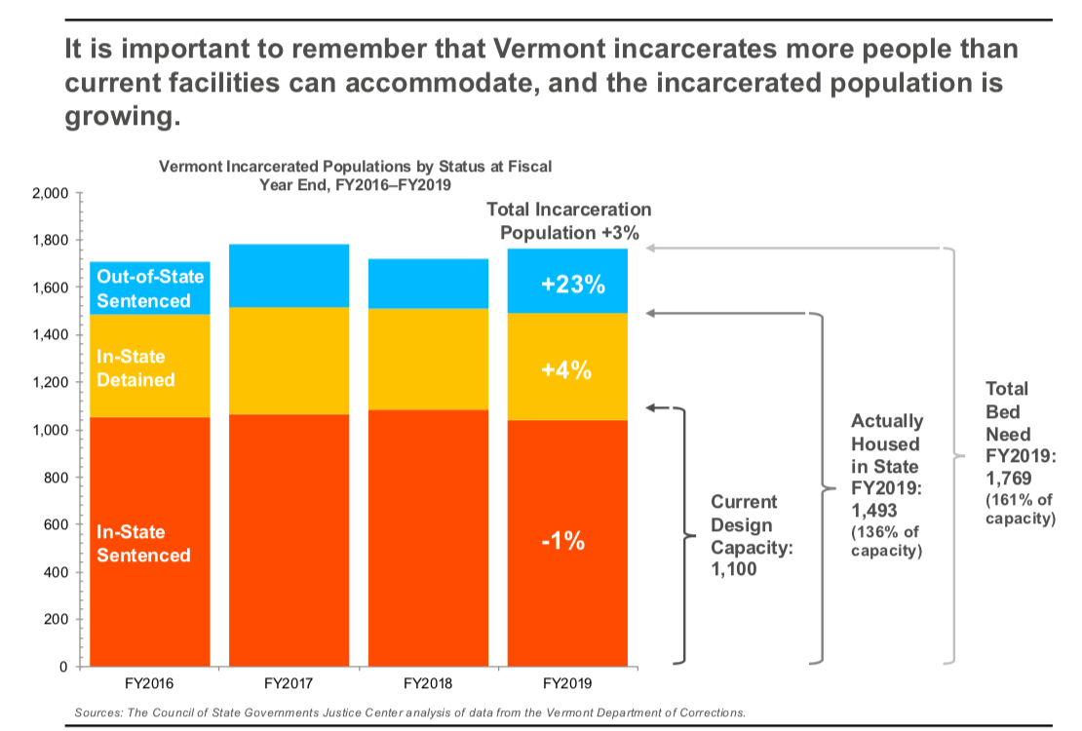

Slide 14
